Slide 1

The Social Responsibilities of Businesses

Slide 2
Shareholder Theory

Slide 3
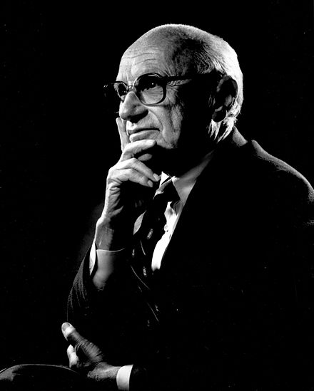
Shareholder Theory
Milton Friedman 1912-2006
Notes:
Shareholder theory is attributed to Milton Friedman, an economist.

Slide 4
Shareholder Theory
Milton Friedman 1912-2006
The only responsibility of business is to maximize shareholder value

Slide 5
Shareholder Theory
A shareholder is someone who owns stock in the corporation

Slide 6
Shareholder Theory
A shareholder is someone who owns stock in the corporation
A business maximizes the value of stock by maximizing profits

Slide 7
Shareholder Theory
“there is one and only one social responsibility of business–to use its resources and engage in activities designed to increase its profits so long as it stays within the rules of the game, which is to say, engages in open and free competition without deception or fraud.”
-Milton Friedman

Slide 8
Opposing Argument to Shareholder Theory
Market Failures

Slide 9
Opposing Argument to Shareholder Theory
Phillip Arrow has 2 effects of maximizing profits that are undesirable to society
Notes:
Phillip Arrow describes 2 categories of undesirable effects.

Slide 10
Opposing Argument to Shareholder Theory
Phillip Arrow has 2 effects of maximizing profits that are undesirable to society
When an action poses a greater cost to society than to the imposer of the cost.
Notes:
The first undesirable effect of shareholder theory occurs when an action poses a greater cost to society than to the imposer of the cost.

Slide 11
Opposing Argument to Shareholder Theory
Phillip Arrow has 2 effects of maximizing profits that are undesirable to society
When an action poses a greater cost to society than to the imposer of the cost.
Examples:
Pollution
Traffic congestion
Notes:
Pollution and traffic congestion. Putting more cars on the road may be the best way to maximize profits. The cost imposed on others by putting more cars on the road is not imposed on the business that chooses to put more cars on the road.

Slide 12
Opposing Argument to Shareholder Theory
Phillip Arrow has 2 effects of maximizing profits that are undesirable to society
2. Asymmetric information
Notes:
2. Asymmetric information

Slide 13
Opposing Argument to Shareholder Theory
Phillip Arrow has 2 effects of maximizing profits that are undesirable to society
2. Asymmetric information
Examples:
The car salesperson knows more about the defects of the car than the buyer
Notes:
Asymmetric information. An example of asymmetric information car sales at a used car lot. The car salesperson knows more about the defects of the car than the buyer, so the buyer, who makes the decision, will not have the best information possible.

Slide 14
Solutions to Market Failures
Notes:
The standard solutions to market failures are

Slide 15
Solutions to Market Failures
Regulation
Taxes
Notes:
regulation and taxes. This is what Milton Friedman was talking about when he said

Slide 16
Solutions to Market Failures
Regulation
Taxes
“there is one and only one social responsibility of business–to use its resources and engage in activities designed to increase its profits so long as it stays within the rules of the game, which is to say, engages in open and free competition without deception or fraud.”
-Milton Friedman
Notes:
“within the rules of the game”. Milton Friedman, one of the leaders in shareholder theory, acknowledges the need for rules in the market.

Slide 17
Stakeholder theory
Notes:
Stakeholder theory.

Slide 18
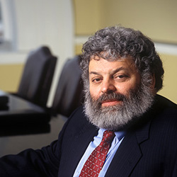
Stakeholder theory
Edward Freeman
Notes:
The main supporter of stakeholder theory is Edward Freeman, a professor at the University of Virginia.

Slide 19
Stakeholder theory
Edward Freeman
Businesses are responsible for maximizing value for many groups, which are called stakeholders
Notes:
Stakeholder theory is different than shareholder theory in that stakeholder theory says to maximize value for many groups, which are called stakeholders.

Slide 20
Stakeholder theory
Edward Freeman
Businesses are responsible for maximizing value for many groups, which are called stakeholders
Shareholders are only one category of stakeholders
Notes:
Shareholders are only one category of stakeholders.

Slide 21
Stakeholder theory
Who is a stakeholder?
Notes:
So who is a stakeholder?

Slide 22
Stakeholder theory
Who is a stakeholder?
→ Anyone effected by the decisions
• The shareholders
• The community
• Customers
• Employees
• Suppliers
• The corporate managers themselves.

Slide 23
Stakeholder theory
Every business decision must take all stakeholders into account
Notes:
Freeman emphasizes that every business decision must take all stakeholders into account.

